Slide 1

Demand for Home Pension and Reverse Mortgage: An Information Provision Survey Experiment
Duk Gyoo Kim Indo Hwang
Yonsei University Bank of Korea
2025 NA-ESA
Oct 12, 2025

Slide 2
The Pressing Problem: Elderly Poverty in Korea
South Korea: A Rapidly Aging Society
Became a "super-aged society" in Dec 2024 (20% aged 65+).
65+ is anticipated to double by 2050.
Highest Elderly Poverty(*) Rate in OECD
40.4% of people aged over 65 live in income poverty.
* Income less than 50% of the median disposable income.
Source: OECD Income Distribution Database, www.oecd.org/social/income-distribution-database.htm (June 2023 version)
Notes:
https://stat.link/pv3isj

Slide 3
A Paradox
Many elderly suffer from lack of income but possess illiquid assets: a residential house.
Liquidating these assets via schemes like home pension could reduce poverty by 13-16 percentage points (Choi et al., 2023; Lee, 2023)
The Striking Reality: Less than 2% Enrollment!
The reverse mortgage plans (the commercial bank equivalent of home pension) are never used.

Slide 4
Research Questions
What would facilitate elderly demand for liquidizing their homes?
Should the home pension scheme be improved?
Should positive aspects be better advertised?
Would the improvement of reverse mortgage plans (by commercial institutions) lead people to choose them over the home pension scheme?

Slide 5
Home Pension and Reverse Mortgage (Korean Context)
Two key schemes for liquidating housing assets in South Korea:
Home Pension (Government-backed)
Purpose: Lifelong annuity / Social insurance against longevity risk.
Eligibility: Aged >55, house value ≤ 1.2 Billion KRW (in official land value*)
Payments: Guaranteed by the government, continue until both spouses die.
Recourse: No recourse
Reverse Mortgage (by Commercial Banks)
Purpose: Loan generating income flow.
Eligibility: Aged >40, no house value restrictions
Payments: Up to 30 years; can stop if bank goes bankrupt or loan exceeds value
Recourse: When sum of payments exceeds market value
* The official value of 1.2B KRW is priced around 1.7B KRW in the market.

Slide 6
Some Facts about the Home Pension
As of September 2024, the average home pensioner is
72 years old*,
* Younger one between spouses
receives a monthly payment of 1.22M KRW (about 870 USD),
living in a house worth 388M KRW.
The number of enrollments: 133,364.

Slide 7
Our Methodology
Information Provision Survey Experiment
providing a different set of information to survey participants and examining the difference (the treatment effect) among their responses
Why?
Appropriate, especially when there have been no policy changes. Since the home pension reform has not been finalized, various virtual conditions can be presented, without raising a concern about the different information processing due to the participants’ prior beliefs about the home pension reforms.
Survey participants
3,820 South Korean adults.
Aged 55-79, own a residential property, not currently enrolled in home pension.
Nationally representative sample.

Slide 8
Experimental Design
After being assessed initial awareness and intention to enroll, participants are randomly assigned to one of four information groups:
G1: Placebo (Control)
Informed about a negligible(*) partial refund of the initial enrollment fee (10,000 KRW).
Purpose: Account for experimenter demand effects.
G2: Varying Payments(**)
Informed about a reform where monthly payments periodically redetermine based on house price changes.
Addresses: Concern about constant payments.
G3: Easing Bequests(**)
Informed about a reform where inheritors have longer repayment periods (3 years) and easier loans.
Addresses: Concern about inheritance difficulty.
G4: Changing Perceptions
Informed that fixed monthly payments + rising house prices = increased bequeathed amount.
Addresses: The idea that the two main concerns (payment amount & bequest) can counteract each other.
* The average initial enrollment fee is about 5,800,000 KRW.
** Prior surveys highlight two major reasons for low uptake: (1) Concern about constant payments that don't reflect rising house prices. (2) Desire for children to inherit an uncollateralized home.

Slide 9
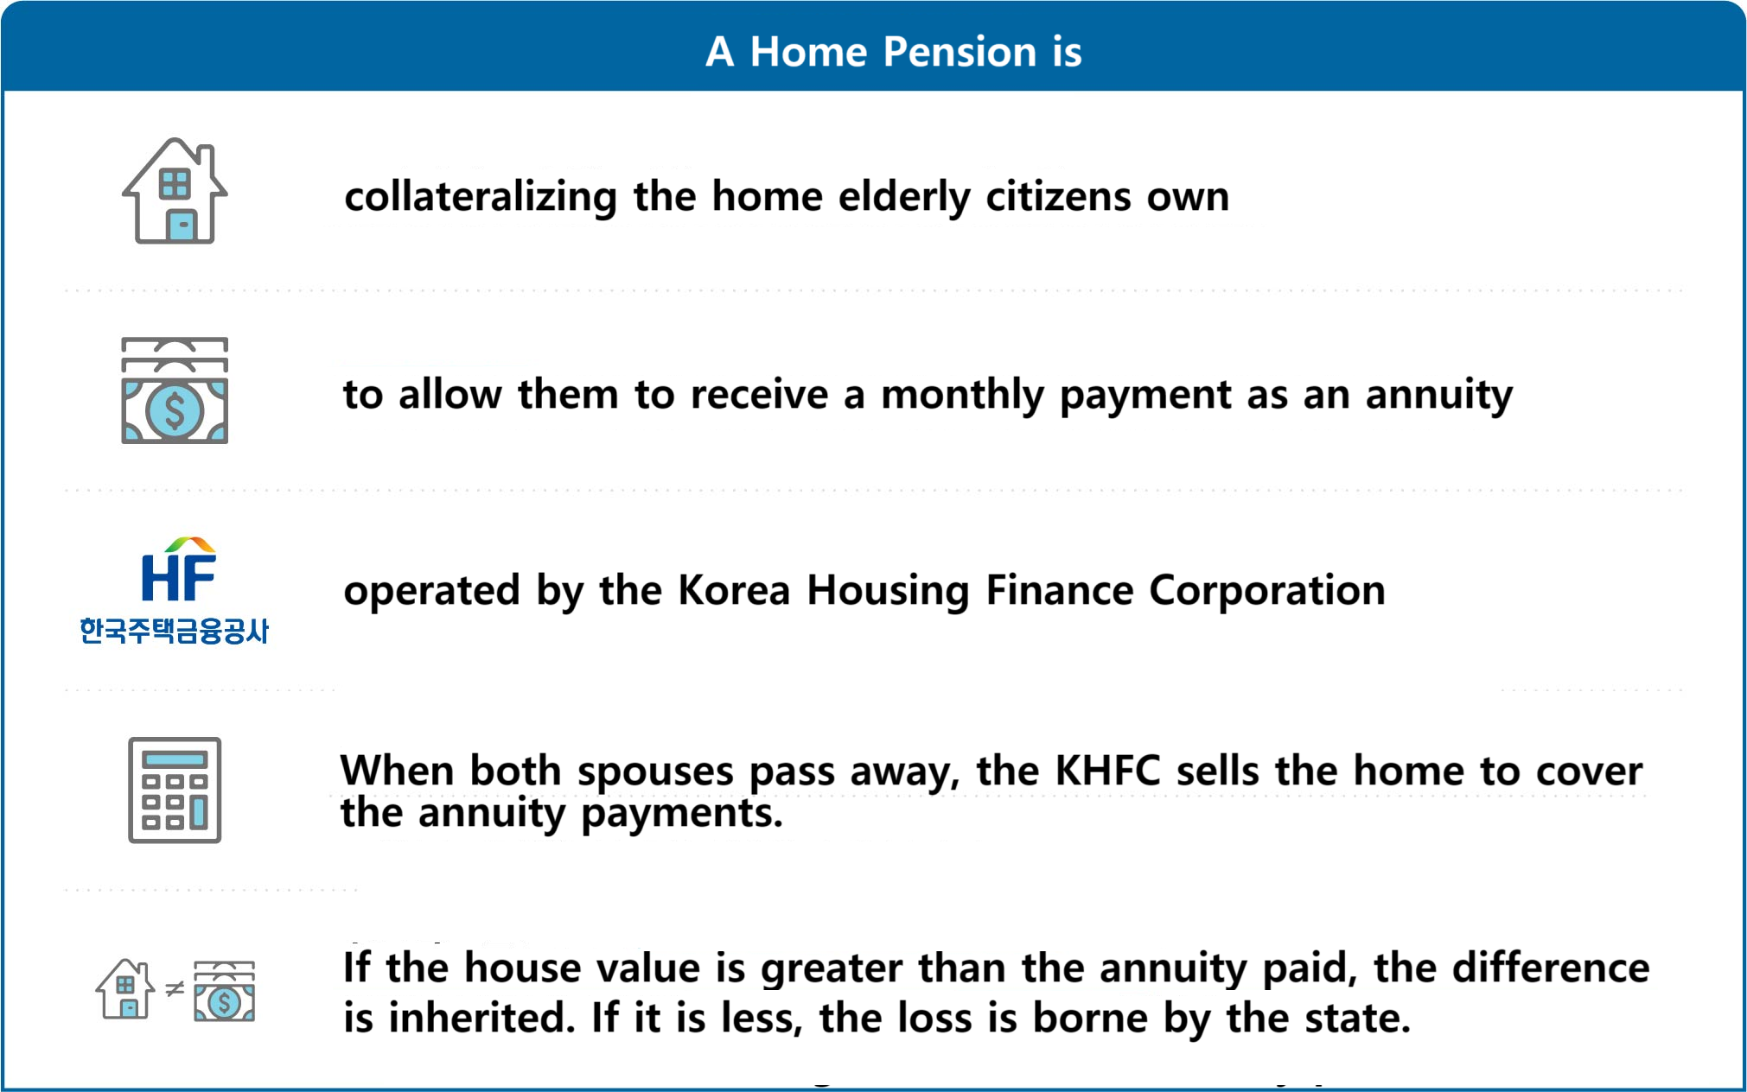
Commonly Provided Information (1/2)

Slide 10
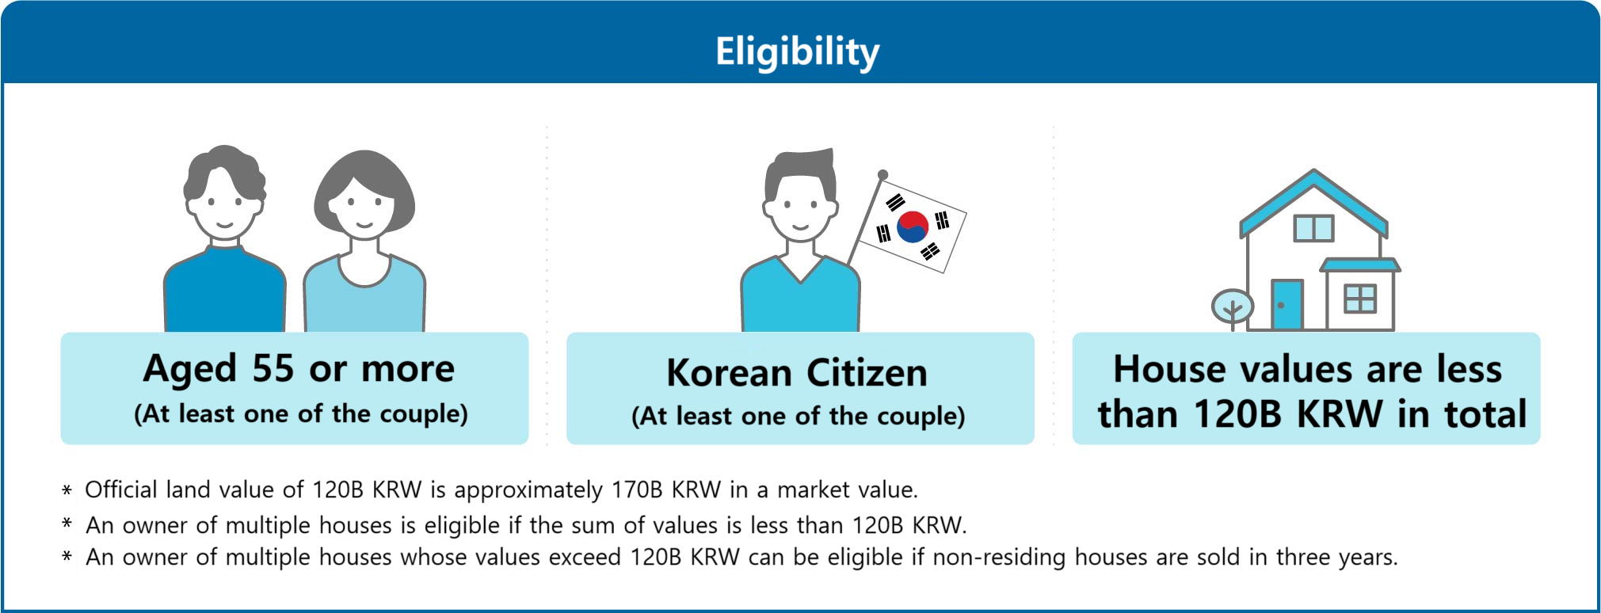
Commonly Provided Information (2/2)

Slide 11
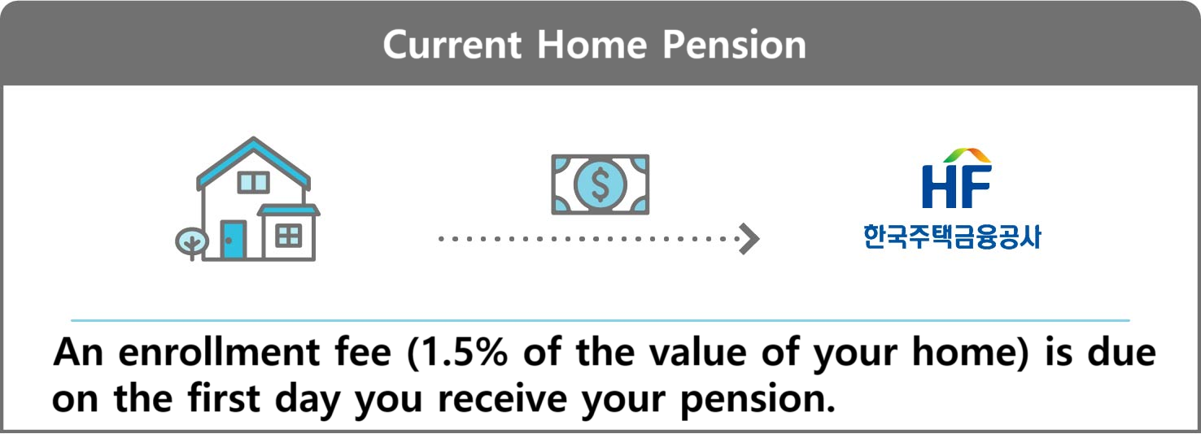
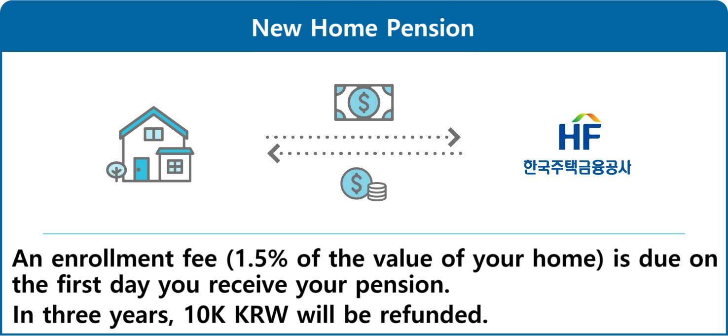
Information Provided to G1 (Placebo)

Slide 12
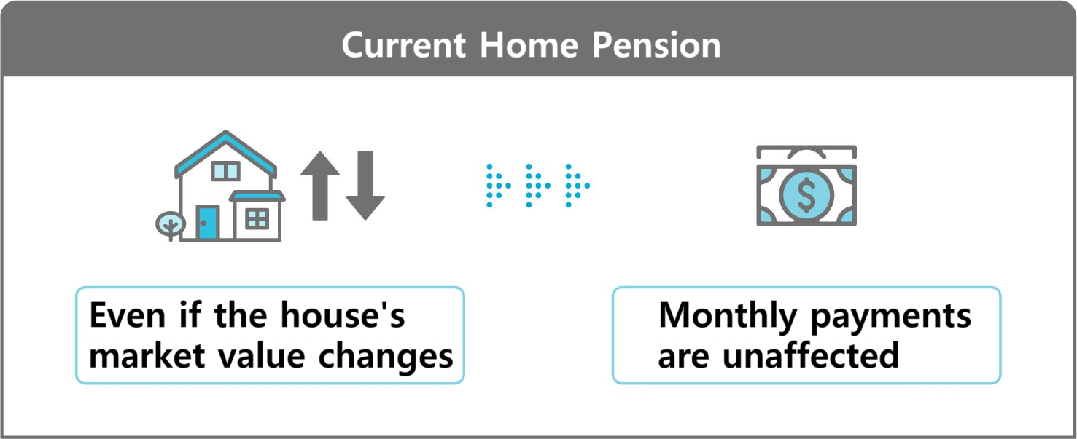
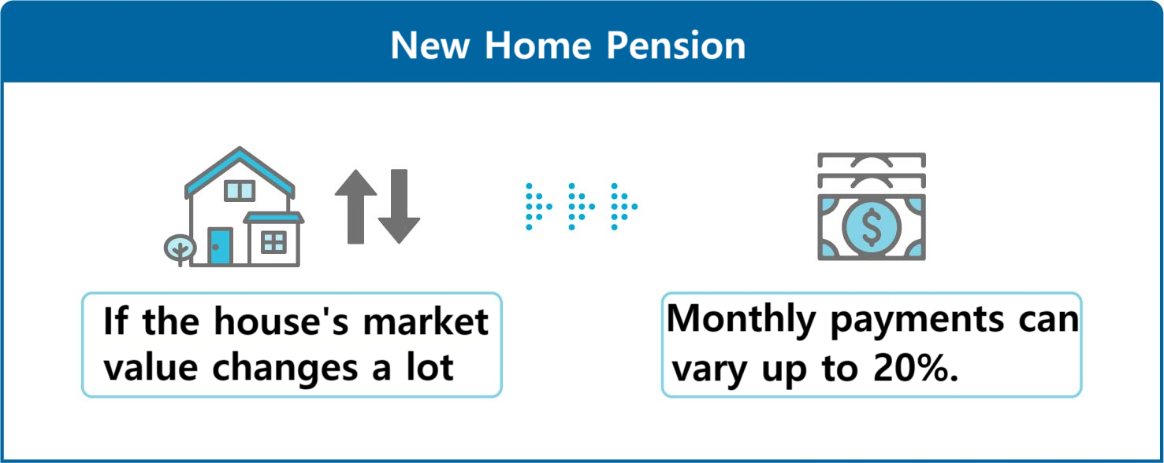
Information Provided to G2 (Varying Payments)

Slide 13
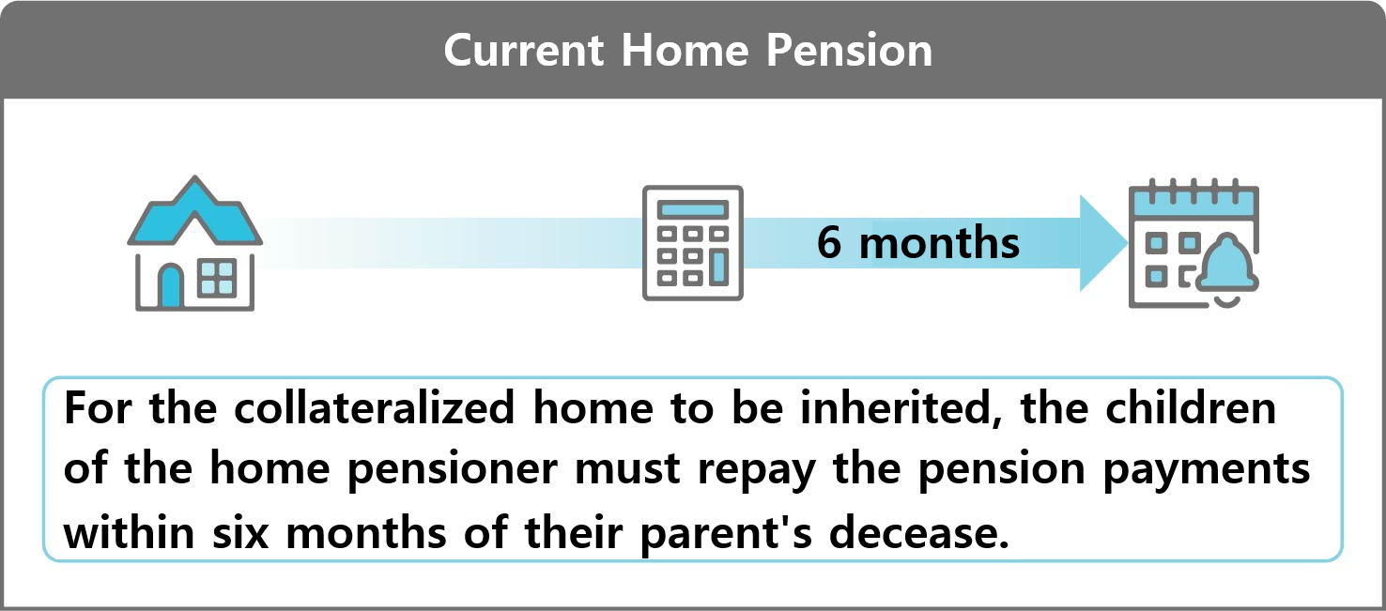
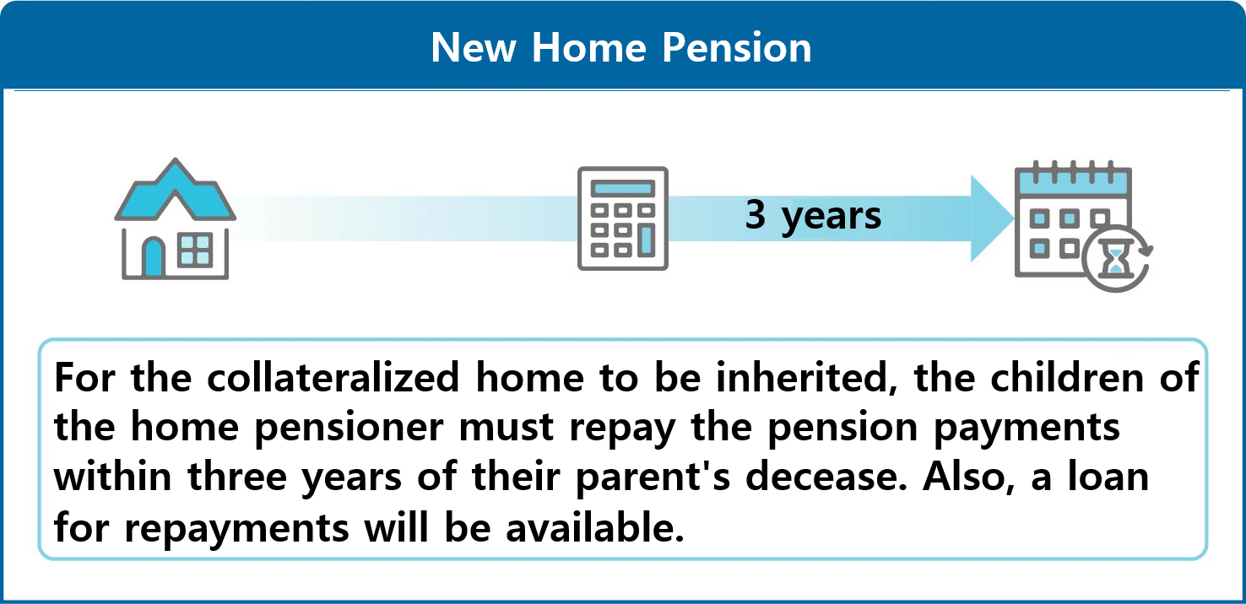
Information Provided to G3 (Easing Bequests)

Slide 14
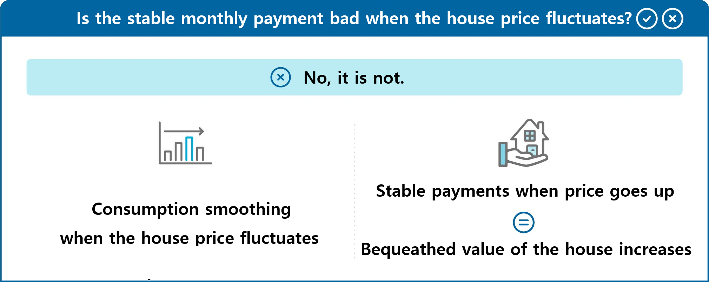
Information Provided to G4 (Changing Perceptions)

Slide 15
Main Results: Changes in Intention
G1 (Placebo): Intention increased by +0.74%p
Statistically insignificant (p=0.419).
Confirms no significant experimenter demand effect. Changes in other groups are due to information, not just receiving information.
G2 (Varying Payments): Intention increased by +6.21%p
G3 (Easing Bequests): Intention increased by +5.24%p
G4 (Changing Perceptions): Intention increased by +7.46%p
Merely informing participants that concerns (e.g., fixed payments vs. bequest) counteract each other is as effective as direct policy reforms.

Slide 16
We can stop it here if time doesn’t permit.

Slide 17
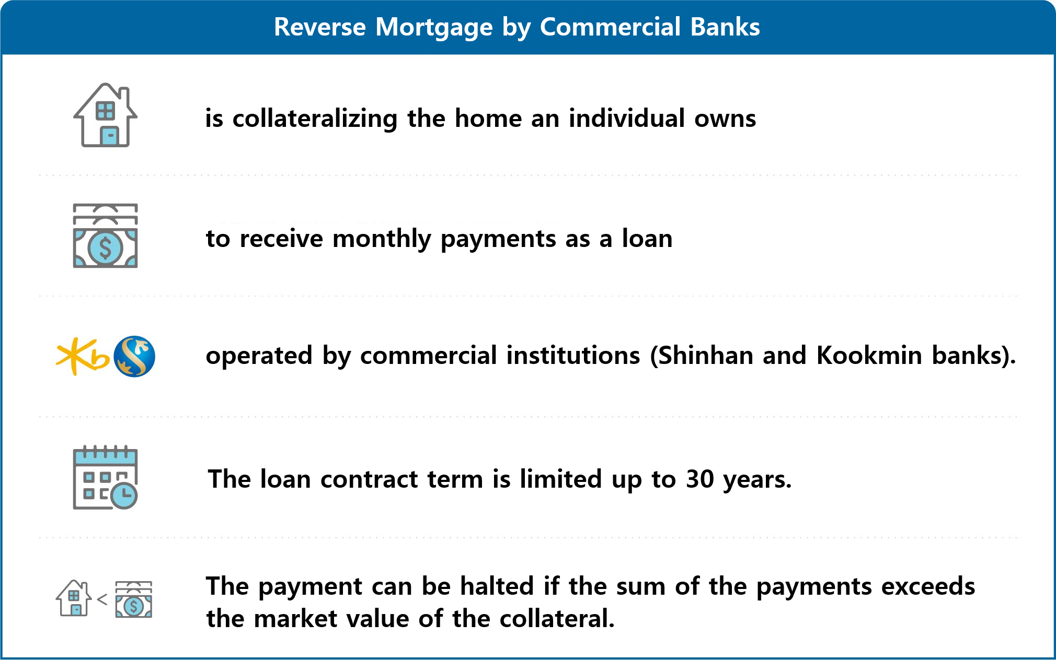
Provided Information about the Reverse Mortgage

Slide 18
Public vs. Private Schemes: Awareness & Initial Preference
Awareness:
Home Pension: 96% familiar.
(So the treatment effect was not driven by making them aware.)
Reverse Mortgage: 54% familiar.
Initial Preference (given identical conditions):
67% preferred Home Pension.
Only 4% preferred Reverse Mortgage.
Primary Reason for Home Pension Preference: "Trust in government agencies".

Slide 19
Potential for Private Reverse Mortgages
While public schemes are preferred, reverse mortgages show growth potential.
When attractive features (mirroring G2/G3 treatments) were introduced to reverse mortgages:
Preference for Reverse Mortgage increased by ~14 percentage points (G2 & G3 treatments).
Desirable features for Reverse Mortgages (beyond mirroring Home Pension):
Extending loan contract for life (mimicking home pension).
Incentives related to medical care expenses and taxes.
Flexible options, including emergency withdrawals.
Private markets can flourish by offering competitive advantages and diverse features, not just by mimicking the public home pension.

Slide 20
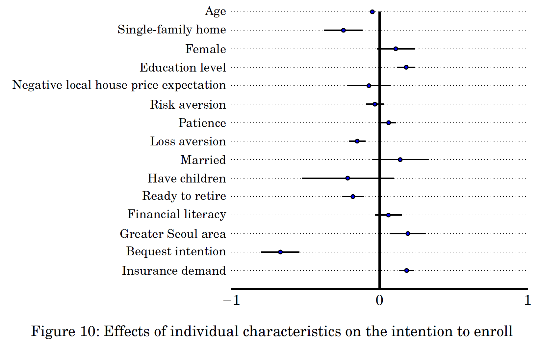
Individual Differences: Initial Intention
Their intention to enroll in the home pension is
weaker for relatively older respondents;
weaker for single-family homeowners (as opposed to the apartment residents);
stronger for the more educated;
stronger for the more patient;
weaker for the more loss averse;
weaker for those who are prepared for retirement;
stronger for those who live in greater Seoul area;
stronger for those who have demand for insurance

Slide 21
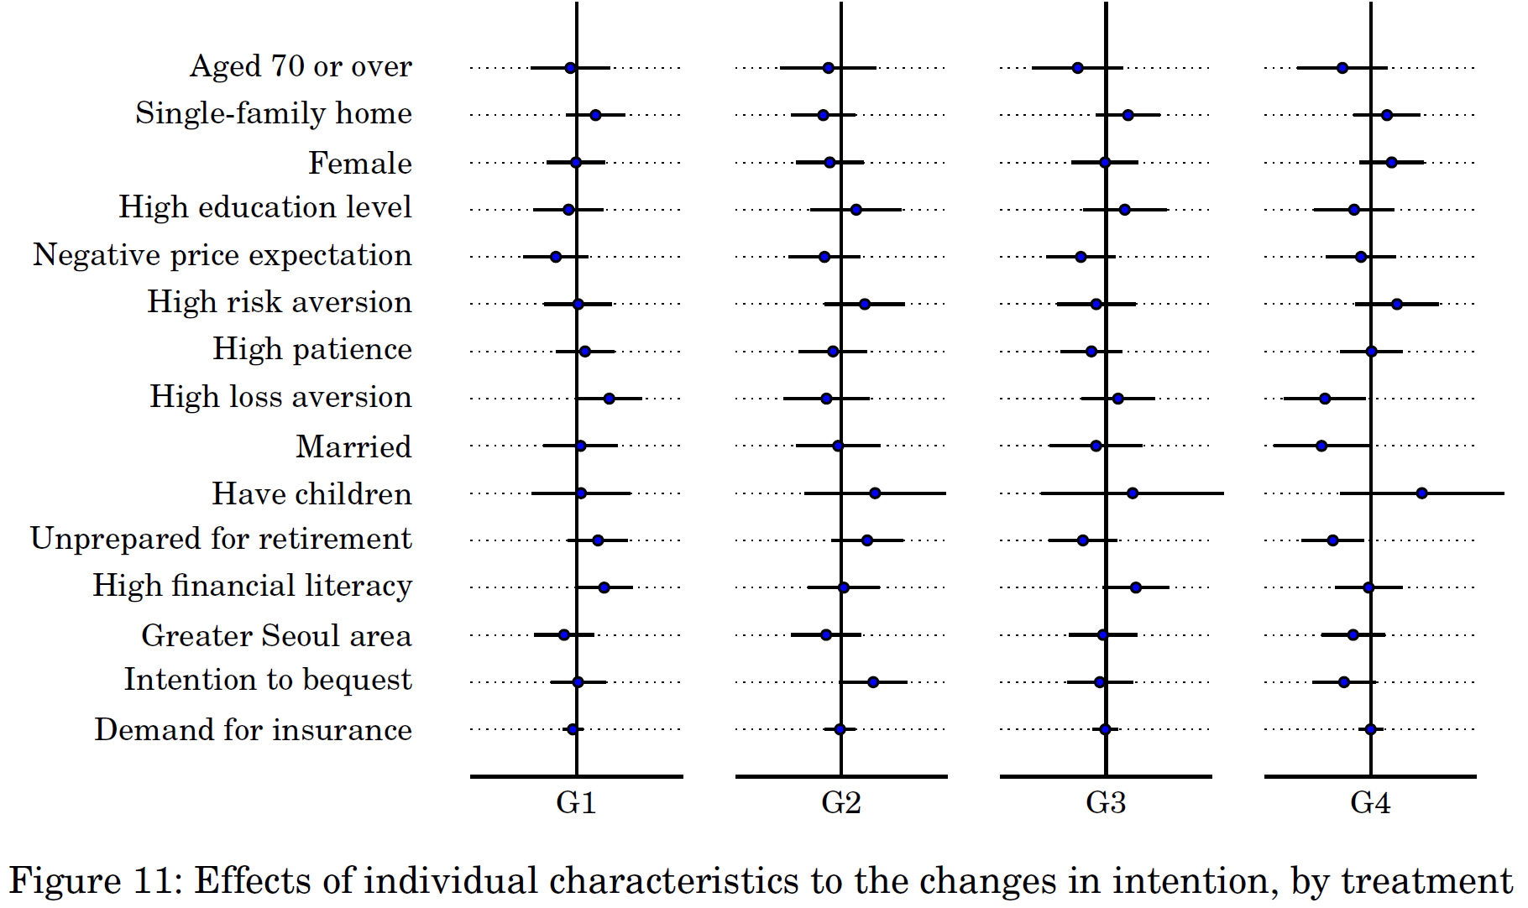
Individual Differences: Response to Information
While individual characteristics explain initial intentions, most do NOT significantly affect the positive change in intention as a response to the provided information,
suggesting that the power of targeted information provision transcends many individual differences in influencing uptake.

Slide 22
Concluding Remarks
Addressing Elderly Poverty in South Korea: Home pension is a vital tool for asset-rich, income-poor elderly.
Boosting Home Pension Uptake:
Can be achieved through policy reforms (e.g., house price-responsive payments, easier inheritance).
Equally effective: Correcting misperceptions and addressing concerns through clear information (e.g., highlighting how fixed payments can increase bequeathed value when house prices rise).
Future of Reverse Mortgages: Private sector can play a role by offering competitive advantages beyond simply mimicking the home pension, such as medical-related incentives and flexible withdrawals.

